Slide 1
THE
COMMERCE
BANK
OF WASHINGTON
ACH Origination for Batch and Transaction Clients
Hosted by: Stephen Wilson, AAP
Moderated by: Stefan Caruso, CTP
Notes:
Welcome to ACH Origination for Batch and Transaction Clients

Slide 2
House Keeping
All lines are muted
Please use Q&A to submit questions
1 Hour Session, 45 minutes on ACH and 15 minutes for Q&A
Recording and slide deck will be available after the call

Slide 3


Your Host and Moderator
Moderator | Host
Stefan Caruso, CTP | Stephen Wilson, AAP
Stefan manages Cash Management Operations for The Commerce Bank of Washington. Stefan is a Certified Treasury Professional. | Stephen manages ACH Operations for The Commerce Bank of Washington. Stephen is a recognized Accredited ACH Professional.

Slide 4
Agenda
Overview of new Online Banking Service
Enhancements to Online Banking
Creating Single Transactions
Creating a Batch
Overview of Originating Batches and Transactions
Q&A
Notes:
We are going to take a look at how Online Banking will be changing. Next, Enhancements to Online Banking. We will also look at creating single transactions and batches. Once we have created a batch, we’ll look at originating the batch. Finally, we’ll take your questions.

Slide 5

New Online Banking Service
The new service will be available Monday September 23, 2013
Notes:
Online Banking will change on September 23.

Slide 6
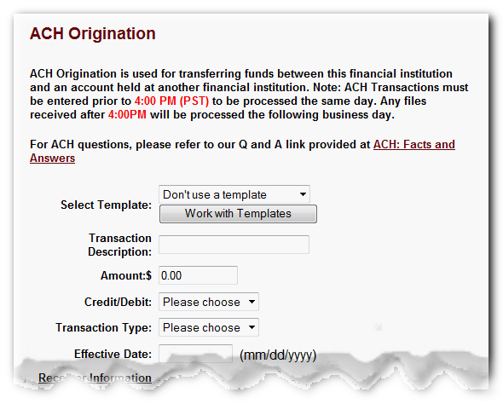
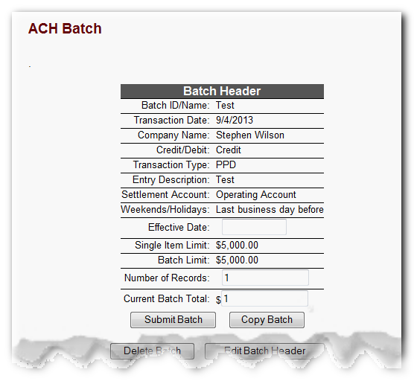
Overview – Legacy ACH Origination
Legacy ACH Transactions
Legacy ACH Batches
Notes:
With the legacy online banking system was split into Transactions and Batches. Our new service will be reorganized to better fit your operation processes.

Slide 7

Enhancements
Dual Authorization
Enhanced
Reports
Transaction Authorization Codes
Notes:
Enhancements to Online Banking will include available Dual Authorization. Transaction Authorization codes and enhanced reporting.

Slide 8
Key Changes
Recipients
Separate Origination Types
  Single Payment
  Single Receipt
  Payroll
  Payments
  Collections
Notes:
A significant change coming is Recipients. This is where you will manage your ACH account information. For example, your employee account numbers. ACH Transactions and Batches are being split into new ACH transaction types. These are geared towards what you wish to accomplish with your transaction. Let’s take a closer look at what Recipients mean on the next slide, then we’ll look at the changes coming to ACH batches.

Slide 9


Recipients
Wire Information
Checking Account
Savings Account
Notes:
Recipients are new feature for Online Banking. Recipients will hold all the account information for individuals and companies. For example, a recipient will hold information for an employee’s checking account for payroll. Also, you will manage who is part of your batches in Recipients.

Slide 10

Batches
Payroll
ACH Batch
Payments
Collections
Notes:
Batches are being split into three separate functions. Payroll is for originating PPD credits to your employees. Payments can be PPD or CCD credits. Payments can be used for disbursements, bonuses or Accounts Payable. Collections can be PPD or CCD debits. That is you can use payments to collect dues, accounts receivable or cash concentration.

Slide 11
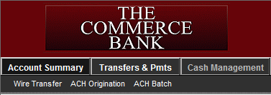
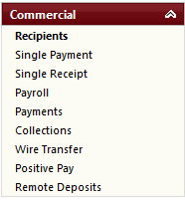
Navigation
Legacy | New Online Banking
In the legacy service, ACH options are grouped under Cash Management. | In the new service, the same options are located in Commercial.
Notes:
Here we have a comparison of the menu options between Legacy and New Online Banking.

Slide 12
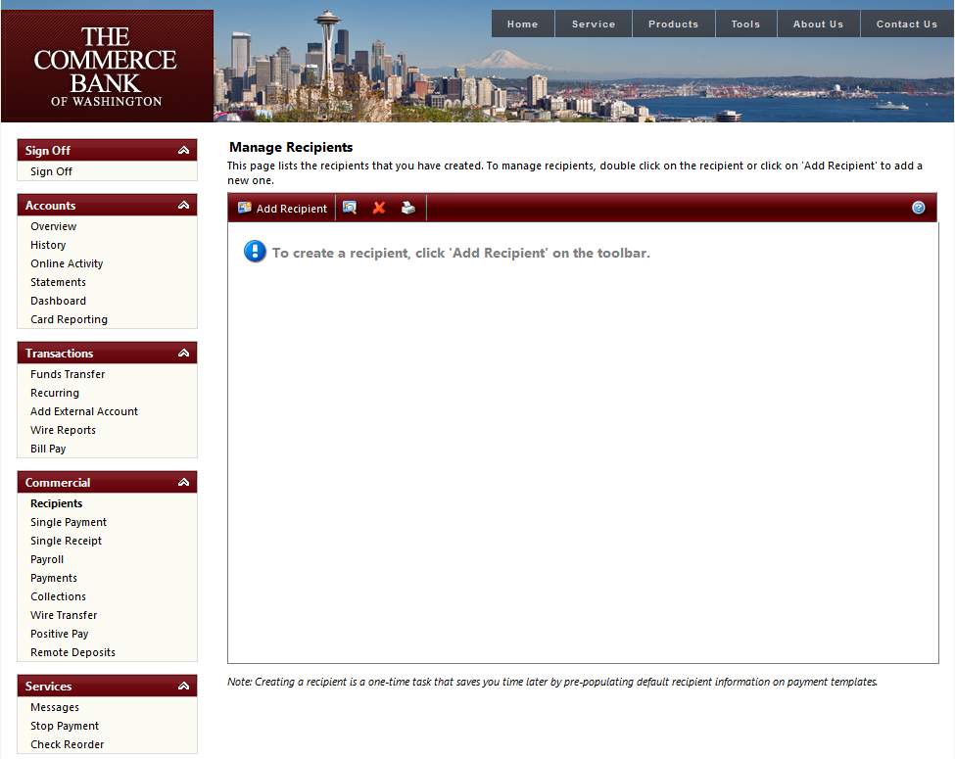
Navigation in Detail
Notes:
Here is your first look at how Online Banking will look come September 23rd. For ACH, the functions are located under the commercial link group.

Slide 13
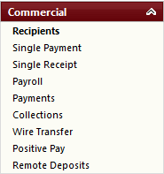
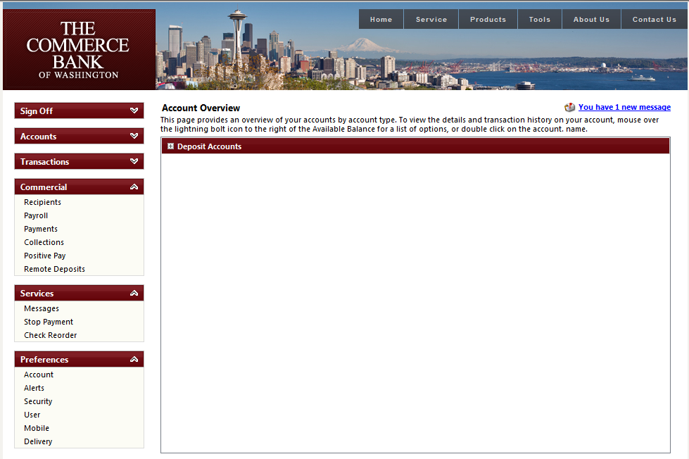
Navigation in Detail
Recipients
Recipients are new feature used to account information
Single Payment
A single ACH credit transaction, similar to ACH Transactions on the Legacy Service
Single Receipt
A single ACH debit transaction, like ACH Transactions on the Legacy Service
Payroll
Originating payroll to your employees similar to batches.
Collections
Cash concentration, Accounts Receivable, dues or etc… Similar to batches
Payments
Disbursements, Accounts Payable and etc.
Notes:
To recap, here are the ACH transaction types located under the Commercial Link group.

Slide 14
Creating a Recipient
Notes:
Let’s take a look at creating a recipient. To get started we’ll click on Recipients.

Slide 15
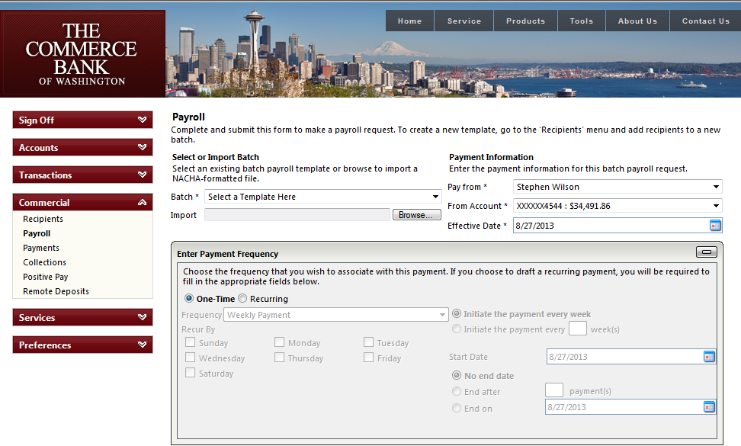
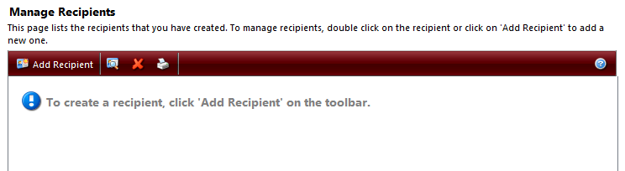
Entering Recipient Information
Notes:
Within the recipients screen, we’ll click on Add Recipient.

Slide 16
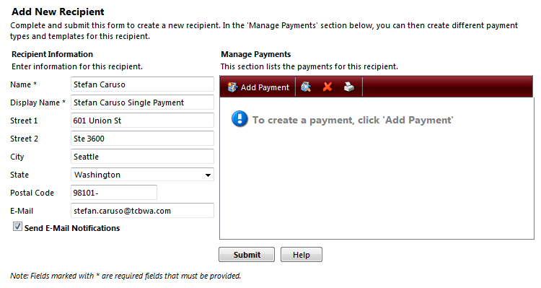
Entering Recipient Information
Notes:
With a recipient you can add additional information. There are only two required fields for a recipient. Name and Display Name. Name is the name on the account at the other bank. The display name is how you will see the recipient on Online banking. It will not be displayed anywhere else. A new feature is the ability to notify your recipient of transaction originated to their account. The notification are sent via email and the email address will need to be populated. The field supports only one email address.

Slide 17
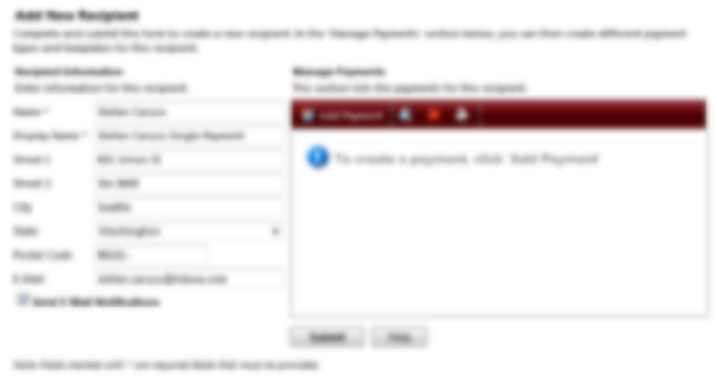
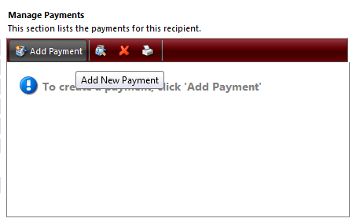
Entering Recipient Information
Notes:
Next we need to add a payment. This is where we will create a single ACH payment. This is similar to ACH Transactions with the Legacy Online Banking service.

Slide 18
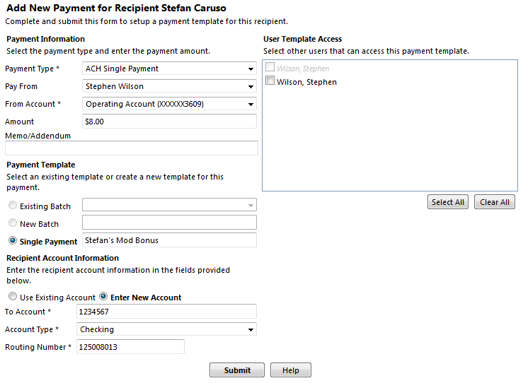
Entering Payment Information
Notes:
From the payment screen, we’ll select ACH Single Payment. The process for Single Receipt is exactly the same as Single Payment. For our example we will show on Payments.
Select Pay From: This is the company you wish to pay as, or, in other words the company name that will show on the transaction on your receiver’s account. In most cases, there will be only one option in this menu.
From Account: This is the account that will fund the transfer. In the case of Single Receipt, it will be the account that is credited for the payment.
Amount is for the sum of the transfer.
Memo/Addendum is used to add additional information a transaction. Often banks do not include this on statements or online banking. It is an optional field.
Since we are creating a single Payment, our template option will be defaulted to the Single Payment field. Enter a name for template. This name will only appear on Online Banking.
Enter the account information for your receiver. If you have added other payments to this particular recipient, you can select that information by using Existing account option. For our example, we’ll enter a new account number.

Slide 19
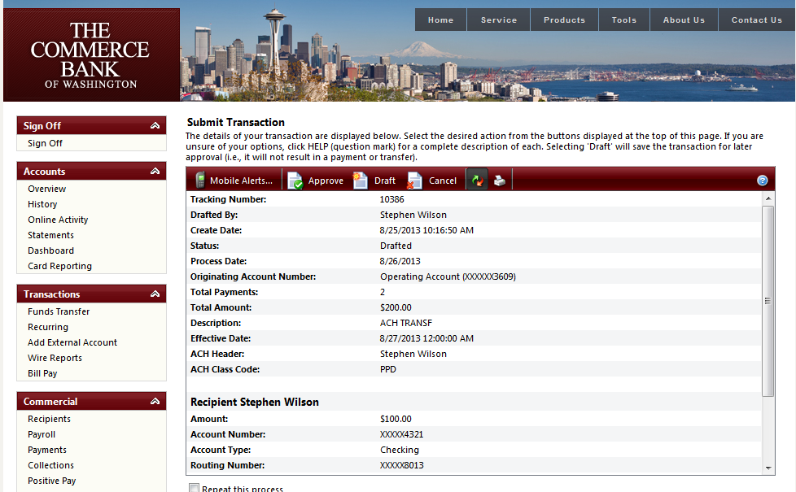
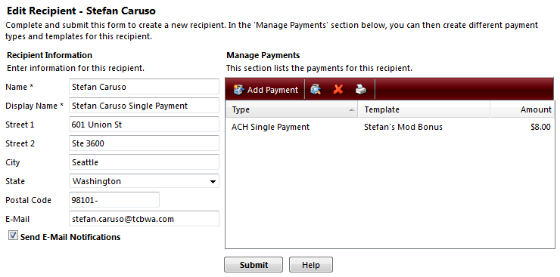
Finishing adding a Single Payment
Notes:
Click submit and you will be taken back to the recipient page. Here you will see you recipient information and the new payment listed on the right. This is similar to working with Templates on the legacy Online Banking service. Like the templates, this transaction has not been sent out for prcoessing.

Slide 20
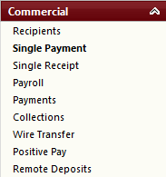
Originating the Single Payment
Notes:
Next we’ll click on Single Payment from the Commercial menu so we can originate the transaction.

Slide 21
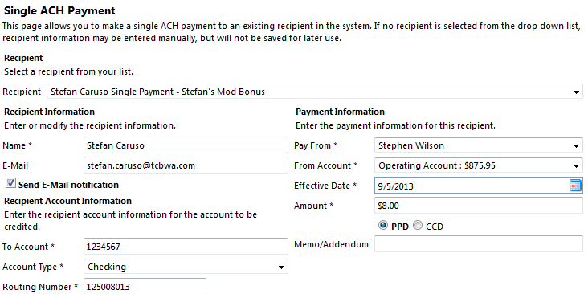
Selecting the Payment
Notes:
In the single ACH Payment Screen, we’ll select a recipient from the drop down list. Here I’ve selected the payment we just created. You will notice that all of the payment information populates below. This is similar to selecting a template on the legacy online system.

Slide 22
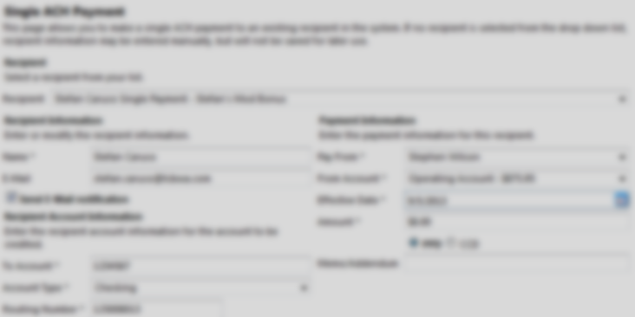
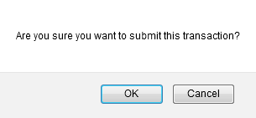
Submitting the Payment
Notes:
Next we’ll click submit. You will be prompted to submit the Single Payment. Click OK.

Slide 23
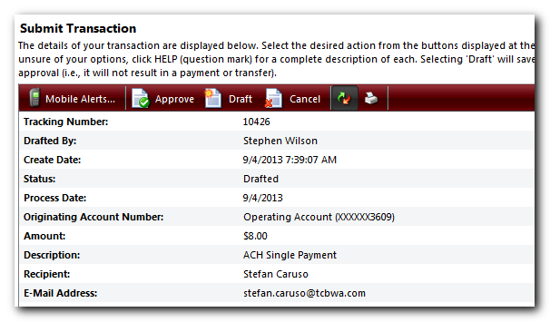
Submitting the Payment
Notes:
Once submitted, you will be taken to the approval screen. We’ll stop here with Single Transactions. Approving a transaction is the same process regardless of the type. We’ll take a look at approving a transaction after we create a payroll batch.

Slide 24
Creating a Batch
Batches are created when the first recipient that will be part of the batch is created.
Notes:
Creating batches occurs when you create your first recipient that will be in the batch.

Slide 25
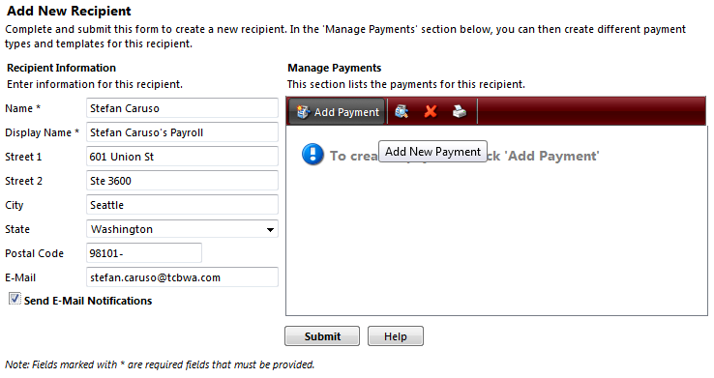
Creating a Batch
Notes:
Like the Single Payment, we are going into Recipients and entering the recipients information. Next we’ll add a payment. The next screen is where we will create the batch.

Slide 26
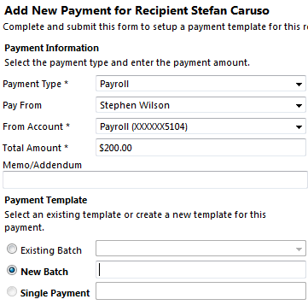
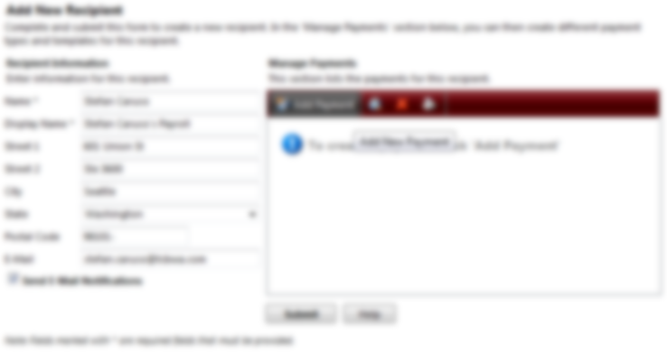
Creating a Batch
Notes:
Batch types are Payroll, Collections and Payments. For our example we create a payroll batch. I’ve selected Payroll, my pay from company, the account I will use to fund the payroll and the amount I will be paying stefan this week. Below I will select New Batch and enter a name for the batch.

Slide 27
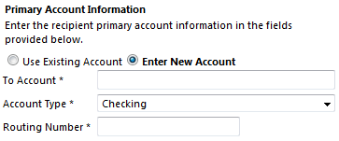
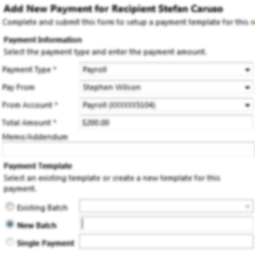
Creating a Batch
Notes:
Next, I will enter Stefan’s account information for the payroll. I’ll click submit to this screen, then finally to the recipient screen. The process is identical to our Single Payment we just created. Next we’ll add a new recipient to an existing batch.

Slide 28
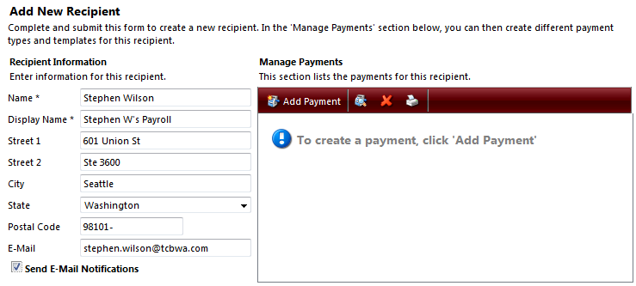
Adding Recipient to a Batch
Notes:
I’ve gone into the Recipient screen and entered my information. Next I will click on add payment to enter my account information and select the batch we just created.

Slide 29
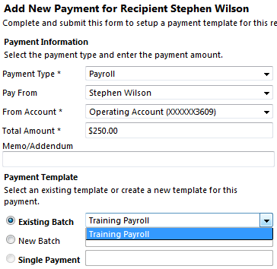

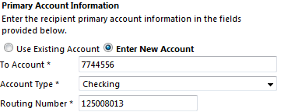
Adding Recipient to a Batch
Notes:
Instead of clicking new batch, I will select Existing Batch and then the batch we just created. Finally, I will enter my payroll information into the payment and click submit.

Slide 30
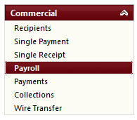
Originating a Batch
Notes:
Now we’ll originate the Payroll batch by clicking on Payroll on the left side. This process is the same for all batch types. You will select the appropriate task from the Commercial menu. For our example, we are continuing with a Payroll batch.

Slide 31
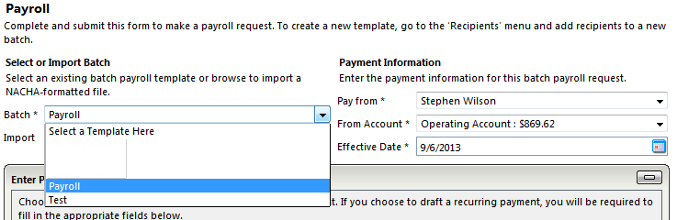
Originating a Batch
Notes:
From the Payroll screen, I will select the Batch drop down and select my Payroll batch.

Slide 32
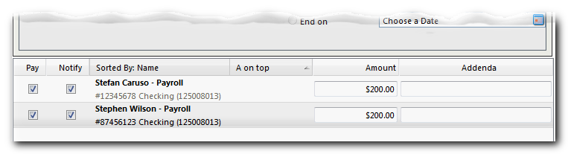
Originating a Batch
Notes:
My employees will be listed below. Similar to the legacy system you can choose whether to pay everyone in the batch or no pay specific individuals. Additionally, you can modify the amount on the fly. There are two key changes in Online Banking. By default all employees are not selected. This is to encourage validation of each entry. Also, you can now notify receivers of their payments. They will receive an email when the bank processes payroll.

Slide 33
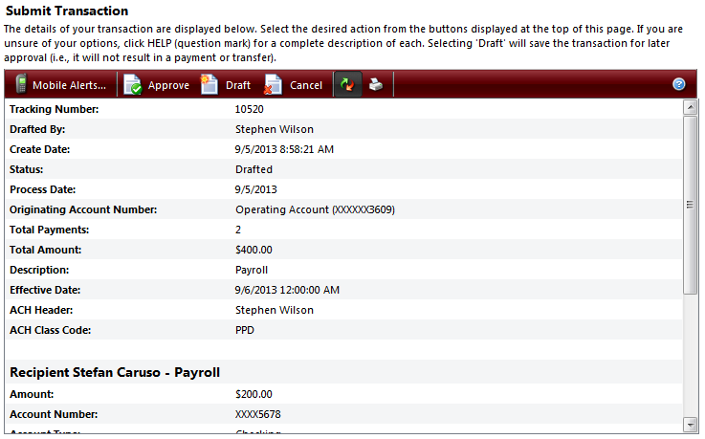
Approving a Batch
Notes:
Now that we’ve selected who to pay and clicked submit, we are taken to the submit transaction screen, this is where we can approve the batch. Approving a batch is identical to approving a single transaction.

Slide 34
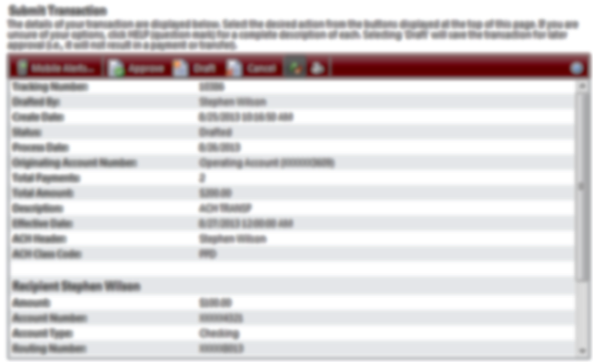
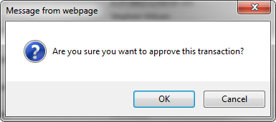
Reviewing and Authorizing
Notes:
We’ll click Approve and be prompted to proceed or cancel. We’ll click OK to proceed.

Slide 35
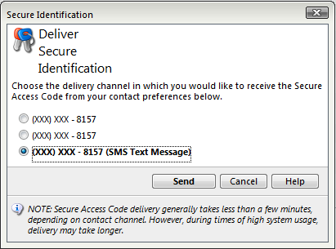
Transaction Authorization Code
Notes:
Here is where Transaction Authorization codes come into the process. Again Transaction Authorization codes are used to validate and approve transactions. These are 6 digit codes delivered via voice call or text message. For our example, we will use text message.

Slide 36
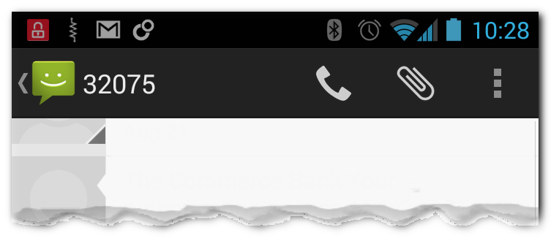
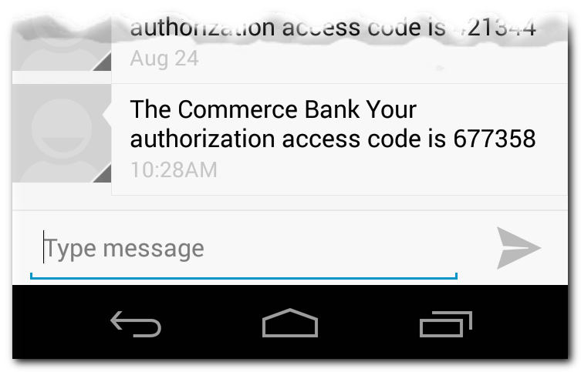
Transaction Authorization Code
Example of a Transaction Authorization Code
Notes:
Here is an example of the code sent via text message.

Slide 37
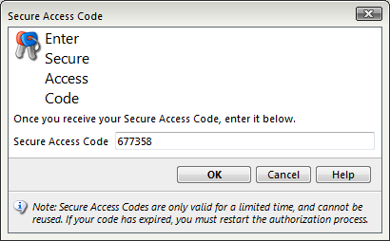
Transaction Authorization Code
Notes:
The code is entered into the Secure Access Code field and we click OK.

Slide 38
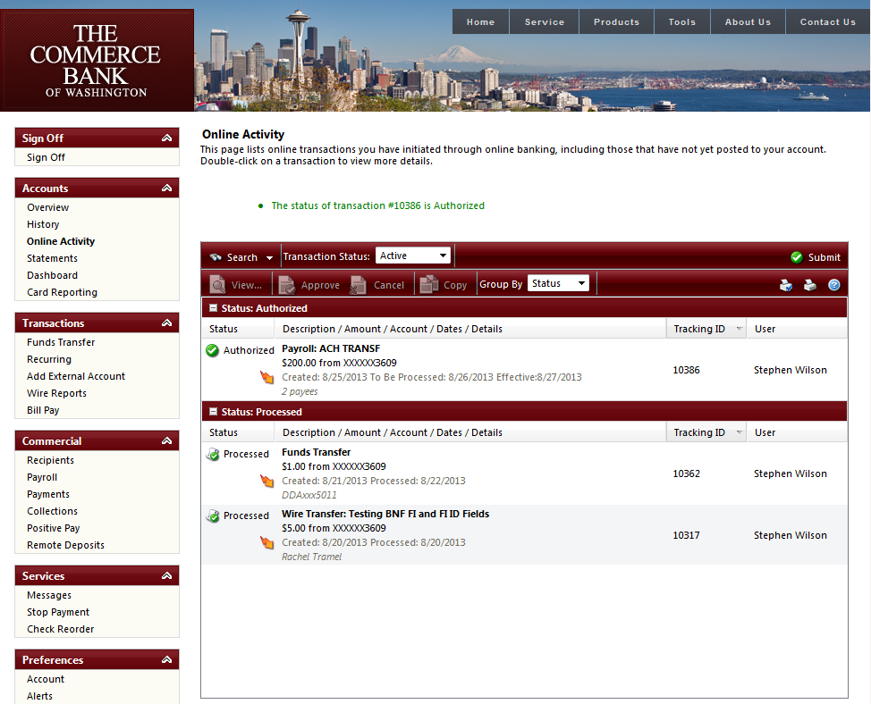
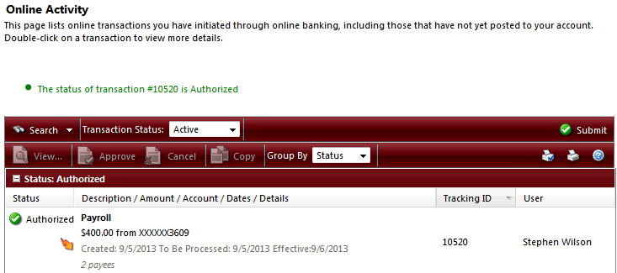
Online Activity
Notes:
You will then be taken to Online Activity where you can see the status of your transaction. Please note the transaction has now been authorized. It is ideal that you log into Online banking between 3 PM and 3:30 PM each business day to ensure your transactions have been approved. We at the bank cannot approve transactions for clients.

Slide 39

Time Frames
Transactions need to be submitted 1 business day prior to the effective date. 2 or more days is ideal.
Daily ACH cut-off is 4 PM
Notes:
A few quick notes about time frames.

Slide 40
New Online Banking Service
The new service will be available Monday September 23, 2013
Notes:
Online Banking will change on September 23.

Slide 41
Questions and Answers

Slide 42
Thank you!
Thank you for joining us today!
Please keep an eye on your email, slides, this recorded session and other information will be sent out soon.
For additional information please email:
ACHDesk@tcbwa.com

