Slide 1
THE
COMMERCE
BANK
OF WASHINGTON
ACH Origination for Send File Clients
Hosted by: Stephen Wilson, AAP
Moderated by: Stefan Caruso, CTP

Slide 2
House Keeping
All lines are muted
Please use Q&A to submit questions
1 Hour Session, 45 minutes on ACH and 15 minutes for Q&A
Recording and slide deck will be available after the call

Slide 3


Your Host and Moderator
Moderator | Host
Stefan Caruso, CTP | Stephen Wilson, AAP
Stefan manages Cash Management Operations for The Commerce Bank of Washington. Stefan is a Certified Treasury Professional. | Stephen manages ACH Operations for The Commerce Bank of Washington. Stephen is a recognized Accredited ACH Professional.

Slide 4
Agenda
Overview of new Online Banking Service
Enhancements to Online Banking
Review new send file origination process
Q&A

Slide 5

New Online Banking Service
The new service will be available Monday September 23, 2013

Slide 6


Overview – Legacy Send File
With the Legacy Online Banking service, you submit your file directly to the bank for processing. This limited transparency and reporting for our clients.

Slide 7

Enhancements
Dual Authorization
Transaction Authorization Codes

Slide 8
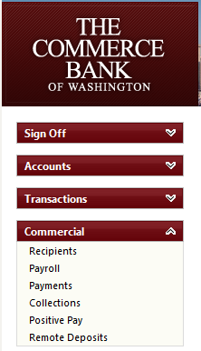
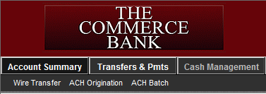
Navigation
Legacy | New Online Banking
In the legacy service, ACH options are grouped under Cash Management. | In the new service, the same options are located in Commercial.

Slide 9
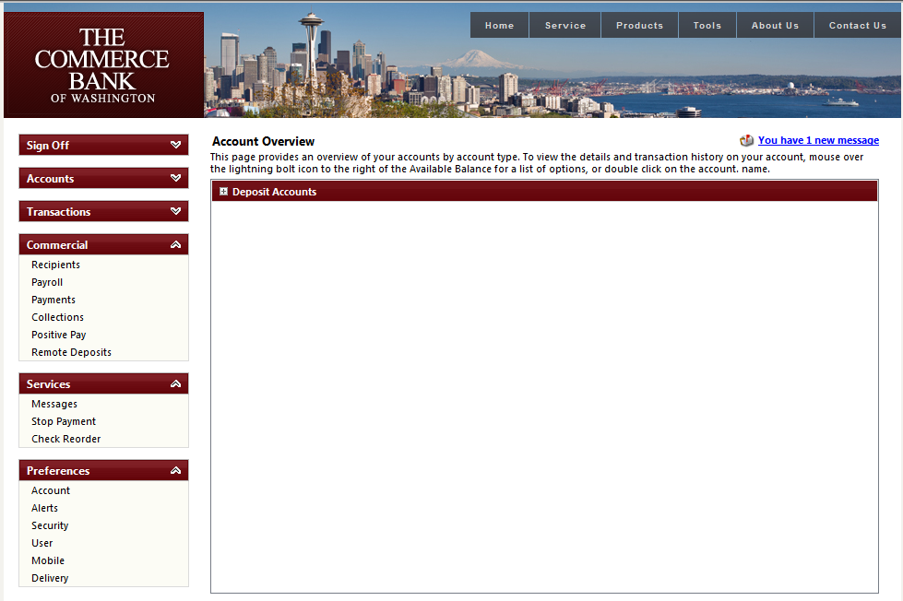
Navigation in Detail

Slide 10
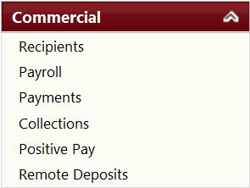
Navigation in Detail
Recipients
Recipients are new feature used primarily for Wire, transactions and ACH managed directly on Online Banking.
Payroll
Originating payroll to your employees.
Payments
Disbursements, Accounts Payable and etc.
Collections
Cash concentration, Accounts Receivable, dues or etc…

Slide 11

Time Frames
Transactions need to be submitted 1 business day prior to the effective date. 2 or more days is ideal.
Daily ACH cut-off is 4 PM

Slide 12
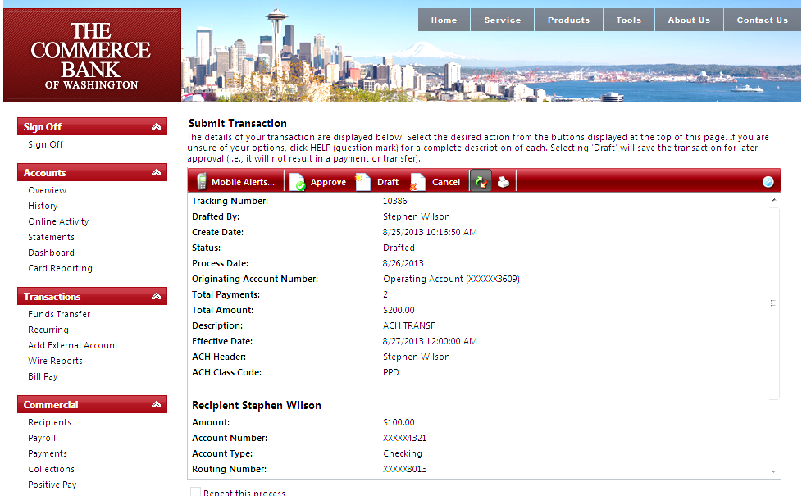
Balanced vs. Unbalanced
Balanced | Unbalanced
The file includes your account here at The Commerce Bank. | Does not include your account number here at The Commerce Bank.
You will be taken directly to the authorization screen in order to originate your file. | You will be prompted to select your offset account after uploading your file.

Slide 13
Importing an ACH File
Select the transaction type
Select the transaction type you wish to originate, in this case, we will process a payroll file.

Slide 14
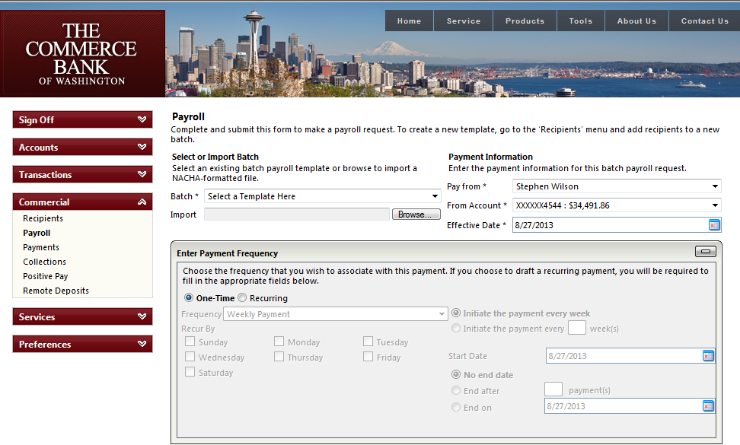
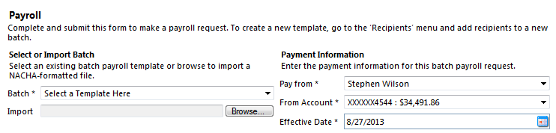
Browsing to the ACH file
Browse to your NACHA file
Click on browse to begin locating your NACHA file.

Slide 15
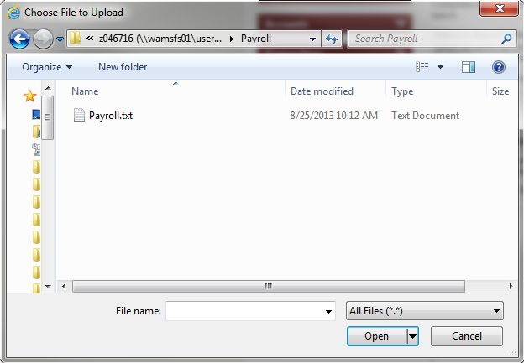
Browsing to the ACH file
Browse to your NACHA file
Just as you would with Send File in the legacy service, browse to the location on your system where you store your NACHA file.

Slide 16
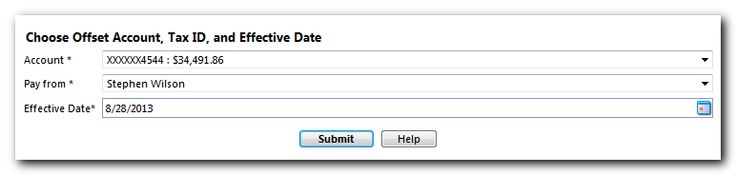
Unbalanced File

Slide 17
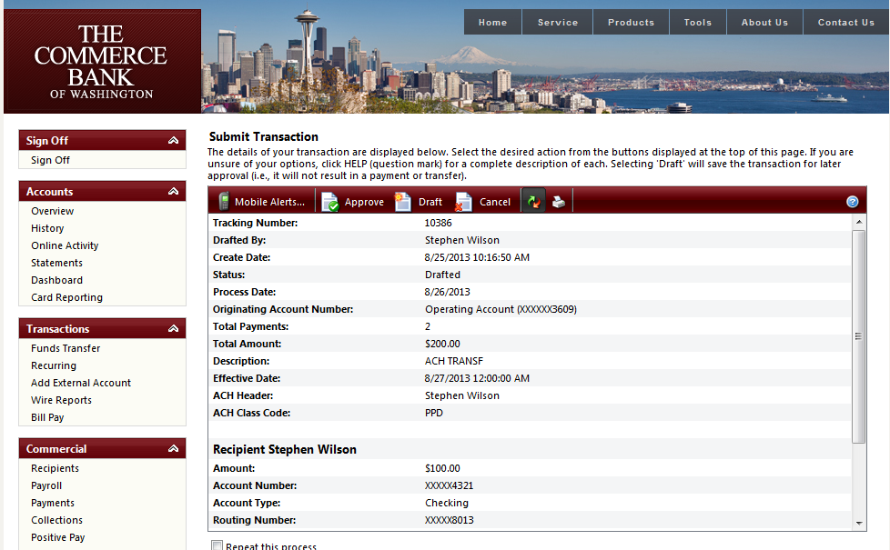
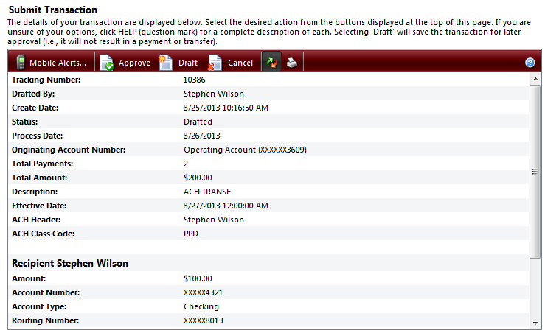
Reviewing and Authorizing
Review your Transactions
From this screen, you have an opportunity to review the transactions that are ready to be authorized.

Slide 18
Reviewing and Authorizing
Authorize
Click on Approve to authorize your transaction.

Slide 19
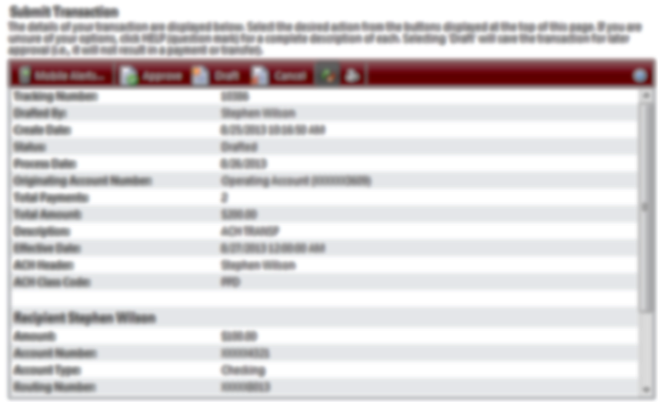
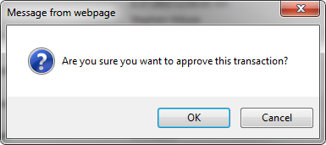
Reviewing and Authorizing

Slide 20
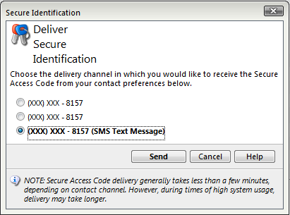
Transaction Authorization Code

Slide 21
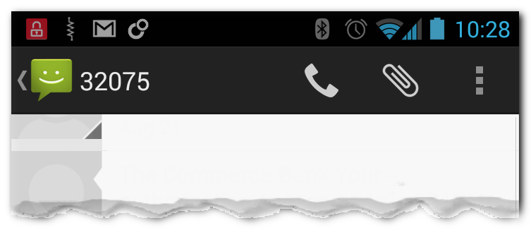
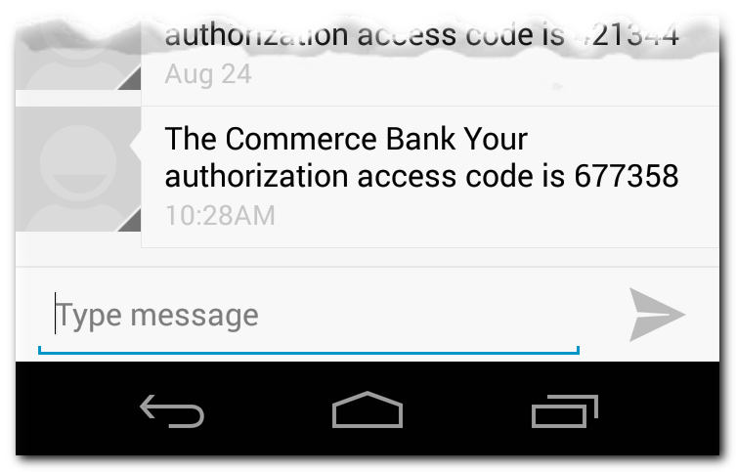
Transaction Authorization Code
Example of a Transaction Authorization Code

Slide 22
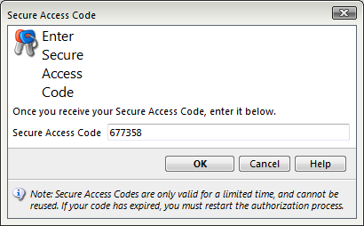
Transaction Authorization Code

Slide 23
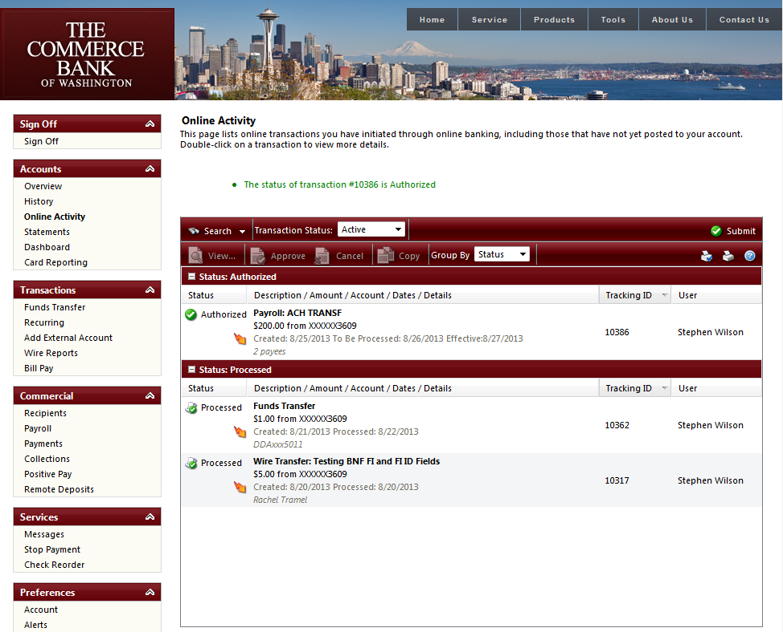
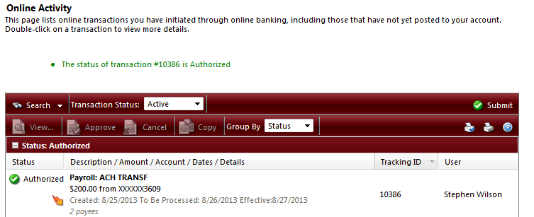
Online Activity

Slide 24
Questions and Answers

Slide 25
Thank you!
Thank you for joining us today!
Please keep an eye on your email, slides, this recorded session and other information will be sent out soon.
For additional information please email:
ACHDesk@tcbwa.com

