Slide 1
THE COMMERCE BANK OF WASHINGTON
Online Positive Pay Service
Hosted by: Stephen Wilson, AAP
Moderated by: Steven Gerlock, CTP

Slide 2
Your Host and Moderator
Moderator | Host
Steven Gerlock, CTP | Stephen Wilson, AAP
Steven overseas the Cash Management and Technology Departments for The Commerce Bank of Washington. Steven is a Certified Treasury Professional. | Stephen manages ACH Operations for The Commerce Bank of Washington. Stephen is a recognized Accredited ACH Professional.

Slide 3
House Keeping
All lines are muted
Please use Q&A to submit questions
1 Hour Session, 45 minutes on Positive Pay and 15 minutes for Q&A
Recording and slide deck will be available after the call

Slide 4
Agenda
Review Positive Pay changes
Import, exception and review process
Q&A

Slide 5
New Positive Pay Service
The new service will be available Monday September 23, 2013

Slide 6
Enhancements
1. Additional Reporting Capabilities
2. ACH Filter
3. Email Notifications

Slide 7
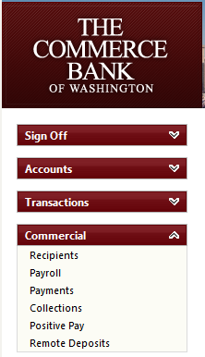
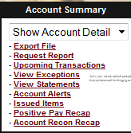
Navigation Changes
Legacy | New Online Banking
In our legacy service, Positive Pay options are available under the Account Summary Section. | In new online banking, Positive Pay is located under the Commercial navigation.

Slide 8
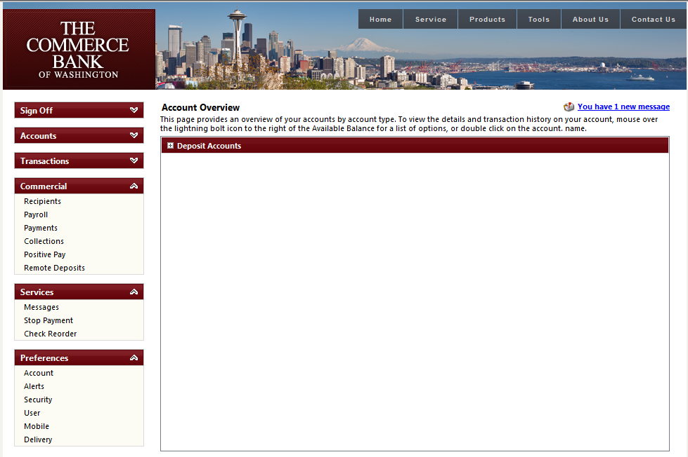
Navigation in Detail

Slide 9
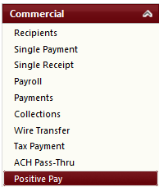
Navigation in Detail
Positive Pay Link

Slide 10
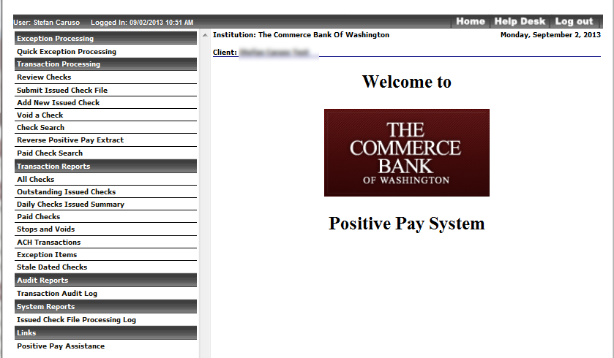
New Positive Pay Service

Slide 11
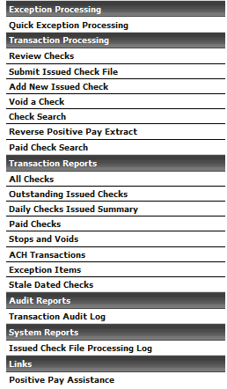
Additional Navigation View

Slide 12
Positive Pay Core Functionality
Submission of Issued Checks
Exception Items
Account Reconciliation

Slide 13
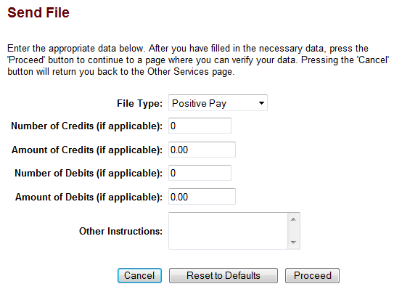
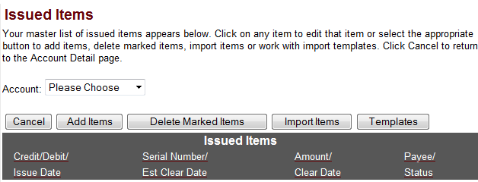
Issued Items Process - Legacy
Send File - Legacy | Issued Items Template - Legacy
Positive Pay Send File | Positive Pay Issued Items Template

Slide 14
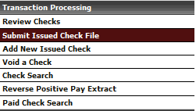
Issued Check File Import

Slide 15
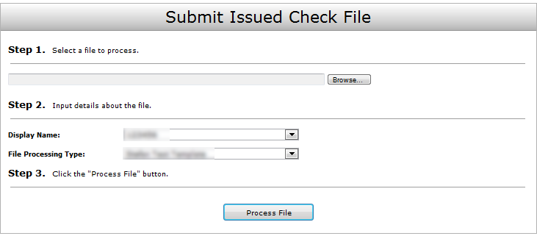
Submit Issued Check File
Browse…
Browse out and locate the file you would like to import.
Display Name: This will be the account name.
File Processing Type: This will be the predefined template used to import in your items.

Slide 16
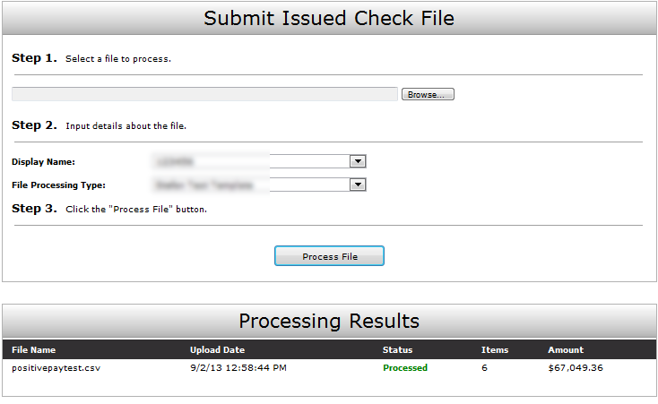
Issued Items Import – Continued
The status column will display the results of the import.

Slide 17
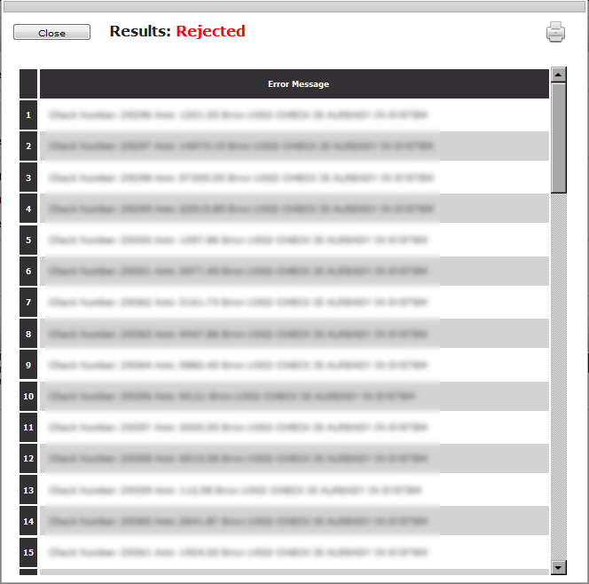
Issued Items – Rejected File

Slide 18
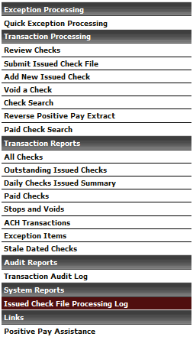
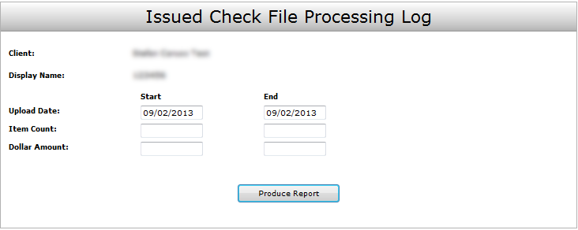
Issued Check File Processing Log
Select the Issued Check File Processing Log to validate the file import process.

Slide 19
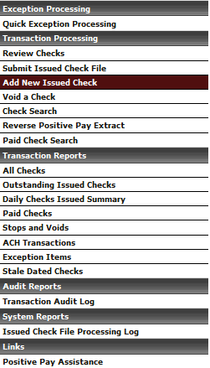
Issued Items – Add New Item

Slide 20
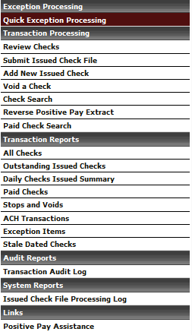
Exception Processing
Exception Timeframe: Exceptions are available for review at 8 AM and must be completed by 12 PM.

Slide 21
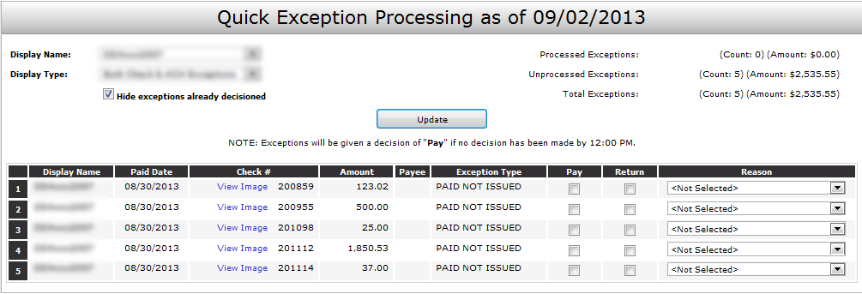
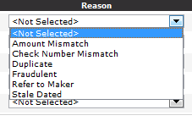
Exception Processing - Checks
Check Return Reason List

Slide 22
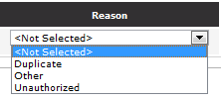
Exception Processing - ACH
ACH Return Reason List

Slide 23
Transaction Reports - Reconciliation
All Checks
Outstanding Issued Checks
Paid Checks
Stops and Voids
ACH Transactions: (If Applicable)
Exception Items
Stale Dated Checks
Transaction Audit Log

Slide 24
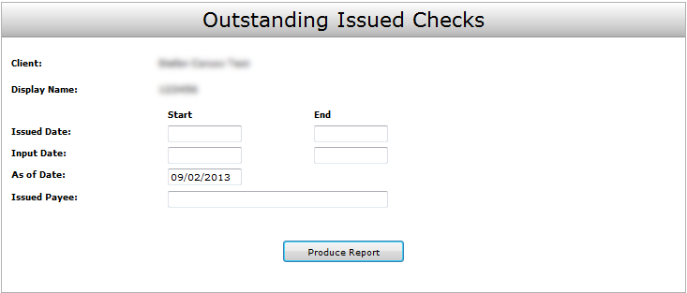
Transaction Reports - Continued

Slide 25
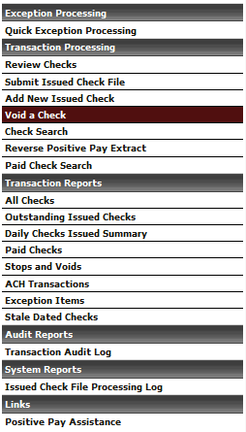
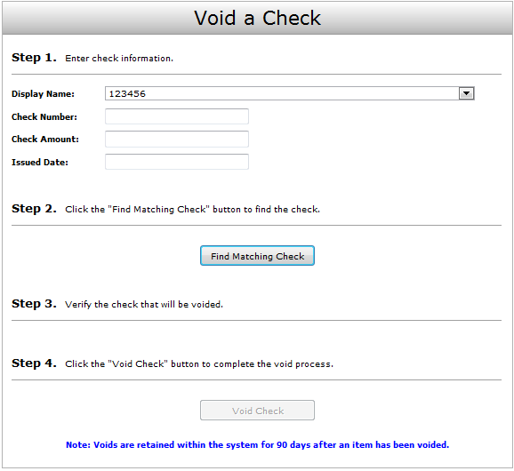
Process a Void
Insert the Check Number, amount and Issue date and click Find Matching Check.

Slide 26
Review
Positive Pay is changing as of September 23rd, 2013.
All Issued File Templates will be mapped to the new service.
Exceptions must be resolved between 8 AM and 12 PM each day.

Slide 27
Questions and Answers

Slide 28
Thank you!
Thank you for joining us today!
Please keep an eye on your email, slides, this recorded session and other information will be sent out soon.
For additional information please email:
CMOPS@tcbwa.com

